Slide 1
Azure Bot Service Overview

Slide 2
Explosive growth
10,000,000+ messages/day
1,000,000+ unique users/day
100,000+ developers
10,000+ active bots
1,000+ companies
100+ new features today

Slide 3



Explosive growth
10,000,000+ messages/day
1,000,000+ unique users/day
100,000+ developers
10,000+ active bots
1,000+ companies
100+ new features today

Slide 4





Why a bot?
TYPE
TALK
TAP
Bot builder
Cortana
Facebook Messenger
Skype
Platform services
Intelligent tools
Bing
Notes:
More natural human / computer interaction
Appealing. Efficient. Easy. Natural.
Adapts to the user depending on circumstance
Available where you are (Web, Mobile, Car, Desktop, …)

Slide 5
Kinds of bots 1,000+ companies engaging us
Scenario | Retail | Finance | Insurance | Telecoms | Government | Automotive | Manufacturing | Healthcare | Media | Events
Customer service | ✔ | ✔ | ✔ | ✔ | ✔ | ✔ | ✔ | ✔ |  | ✔
Customer retail | ✔ | ✔ | ✔ | ✔ |  |  |  | ✔
Audio/speech analysis | ✔ | ✔ | ✔ | ✔ | ✔ |  |  |  | ✔
Translation |  | ✔ | ✔
Surveillance |  | ✔ |  |  | ✔
Knowledge extraction |  | ✔ | ✔ | ✔ |  |  | ✔
Video/photo analysis |  | ✔ |  |  | ✔ |  |  |  | ✔
Product identification | ✔ |  |  |  |  |  | ✔ | ✔
Digital assistant |  |  |  |  |  | ✔
Footfall analysis | ✔ |  |  |  |  |  |  |  |  | ✔
HD maps and object detection |  |  |  |  |  | ✔

Slide 6
Demo
Bots running in Bing Search results
Video Link
Notes:
Moksha Bellevue Link:
https://www.bing.com/search?q=moksha%20Bellevue
Contoso Cafe
https://www.bing.com/search?q=da9c224c-5e2a-4d10-8ea1-a78c8394d403contosocafebuildbot1+bot&setflight=chtbotans
Find café locations
Here are things you can say
Find café locations near me
Where can I get coffee
Find café locations in <city>
Book a table
Here are things you can say
Book a table
book a table for 2
book a table for 2 in redmond
book a table for 2 in redmond for next Thursday 3 PM
At any turn of the conversation, you should be able to provide additional information or correct a previously provided value
User: Book a table for 2 at redmond for next Thursday 3 PM
Bot: Ok, so I've got a table for 2 at Redmond, WA for 18 May at 3 PM. Is that right?
User: no make it seattle and for 4 guests
Bot: You bet, so I've got a table for 4 at Seattle, WA for 18 May at 04 AM. Should I go ahead?
…
Get help
Here are things you can try
Help
What can you do
What can I say
QnA
Here are things you can try
@help who is your ceo?
@help what are your locations?
@help do you have any openings?
Memory
Here are things you can try
Remember redmond as my favorite store
I prefer to get text messages over phone calls

Slide 7


What is a bot?
Platform
Platform services
HTTP
AI
{ Your Code }
Intelligent tools
REST Endpoint
SDK
Bot builder SDK
REST endpoint
Direct Line Protocol
Conversational and business logic
Canvas aware
Context sensitive

Slide 8



What is the bot framework?
What?
Tools for building REST websites
Services to enrich
Mechanisms for receive events
Data to debug and tools to analyze
Why?
Implements standard protocols
Modeling conversations is hard; tools help!
UI across multiple canvases is hard; cards rock!
Language understanding is hard
Common and well understood patterns
Goals
Start simple; add complexity; no dead-ends
Bot adapts to the user, based on context
Composable and intelligent controls to manage complexity
Customer’s
business logic and data
Bot connector
C#
BOT BUILDER
Bot Controls
Skype
Bing
WebChat
LUIS
Form Filling
QnA
Skype for Business
Cortana
Direct Line
Query over database via Azure Search
Third-party

Slide 9
Highlights
Improvements Everywhere!
Bot builder
Platform
Intelligence
SDK updates
Speech support
Improved dialog tools
Debugging improvements
Channel inspector
Improved tooling
New channels
Cortana
Bing
Skype for Business
Adaptive cards
Speech support
Payments
Analytics
Bot controls
Speech support
Cognitive services

Slide 10
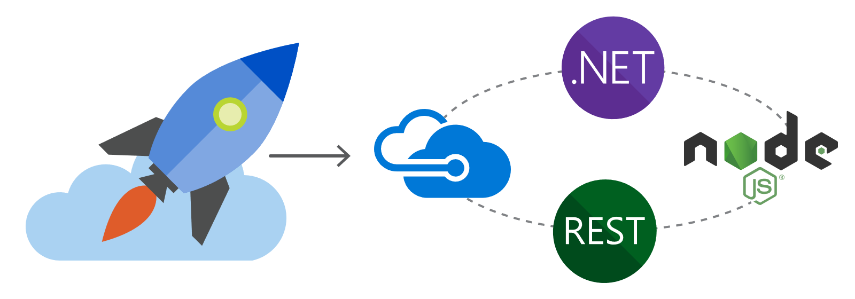
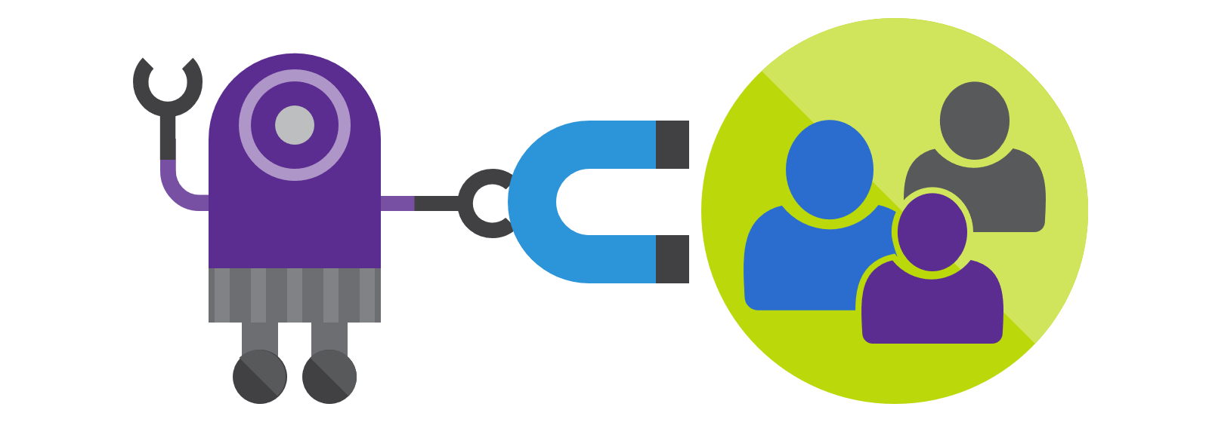
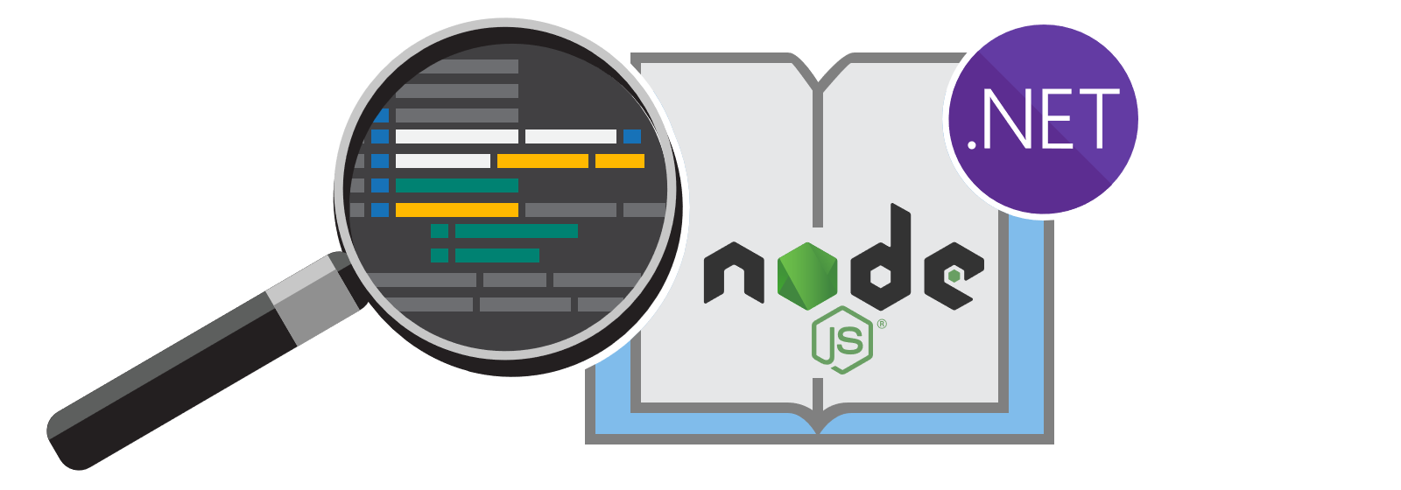
New docs!
#1 Requested Feature
Comprehensive
Bot design
Searchable
Scenario-based
Patterns and practices
Integrated with APIs
Well organized and discoverable
Samples
Easy to read

Slide 11
Demo
New documentation
Notes:
https://review.docs.microsoft.com/en-us/Bot-Framework/index#pivot=main&panel=overview
Show the C#/Node dropdown on:
https://review.docs.microsoft.com/en-us/bot-framework/nodejs/bot-builder-nodejs-dialog-manage-conversation
Show filtering. For example, “Dialog”.
Show the dark theme.
Show the site is responsive.
Show the Adaptive Card help:
https://review.docs.microsoft.com/en-us/bot-framework/dotnet/bot-builder-dotnet-add-rich-card-attachments#a-idadaptive-carda-add-an-adaptive-card-to-a-message

Slide 12











New channels
Improvements Everywhere!
One Bot
Multiple canvases

Slide 13



New channels
One Bot
Multiple canvases
Custom skills
Business bots
LOB bots
Memory/profile
Top bots
IT managed
Speech
Bots in Bing search
Integrated auth

Slide 14
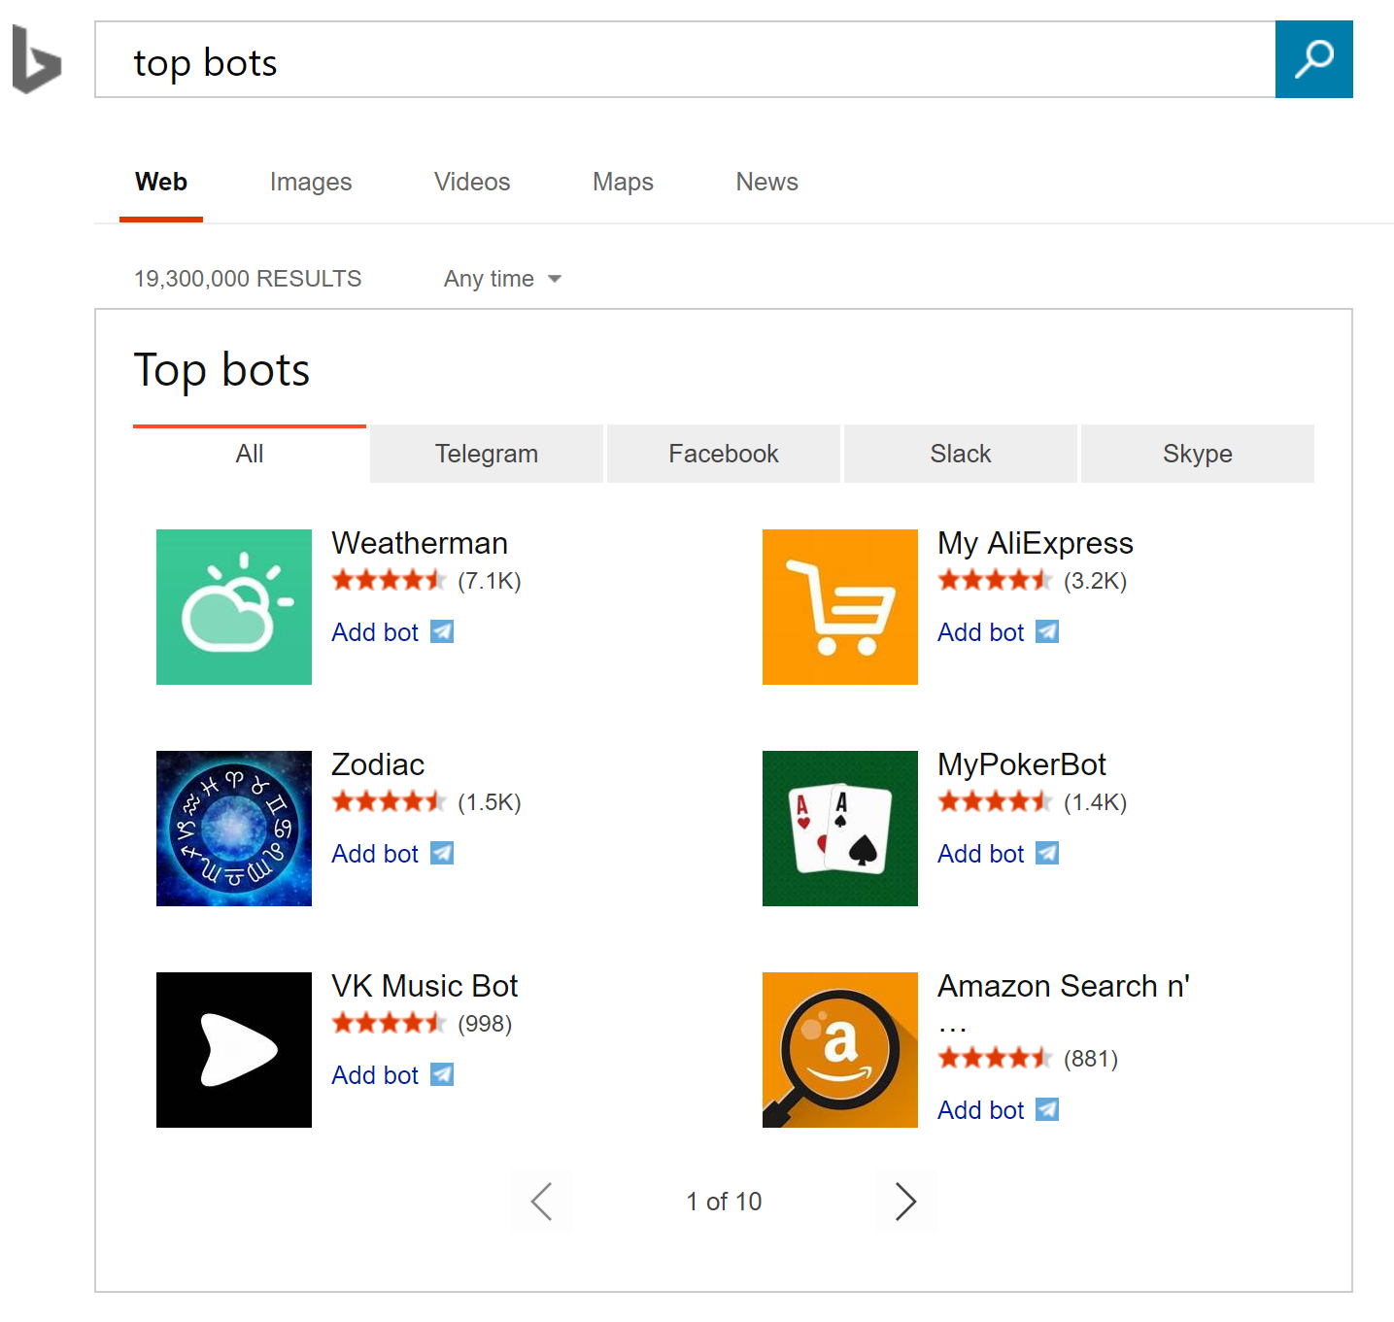
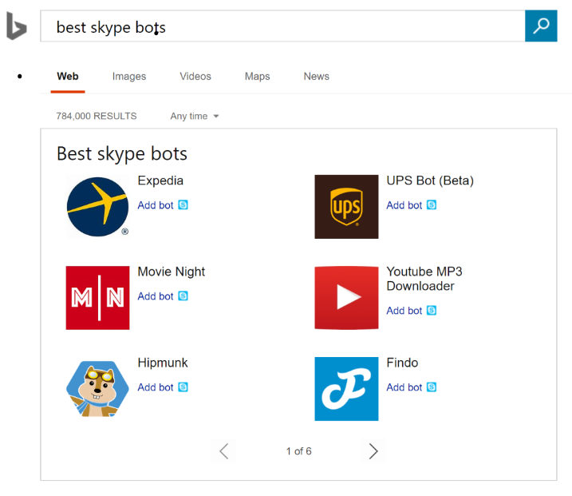
Bot discovery
Bing Search for Bots
Bing Search Terms
Top bots
Top Skype bots
Famous Skype bots
Best Facebook bots
Latest Slack bots

Slide 15
Demo
Adaptive cards
One card, multiple canvases
Notes:
http://adaptivecards-staging.azurewebsites.net/visualizer/
http://adaptivecardsdemo.azurewebsites.net/
https://github.com/Microsoft/AdaptiveCards

Slide 16

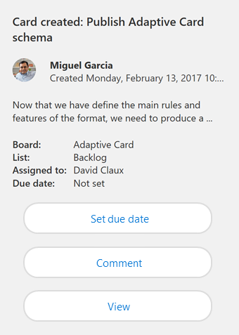
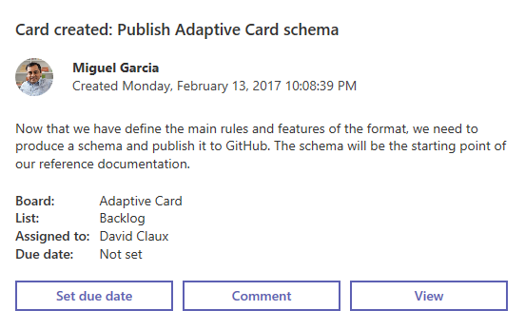
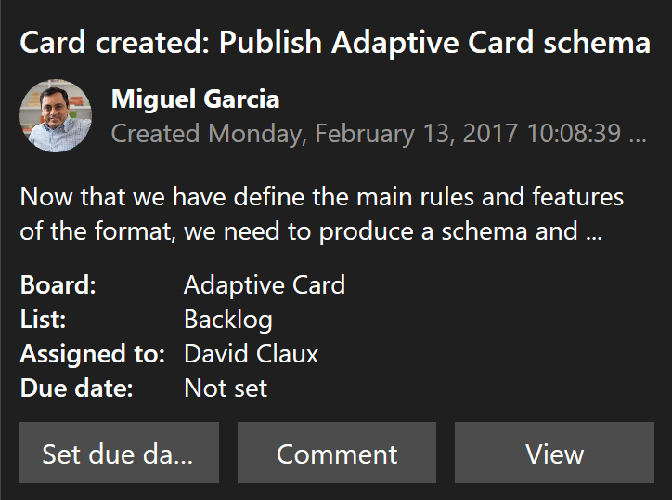
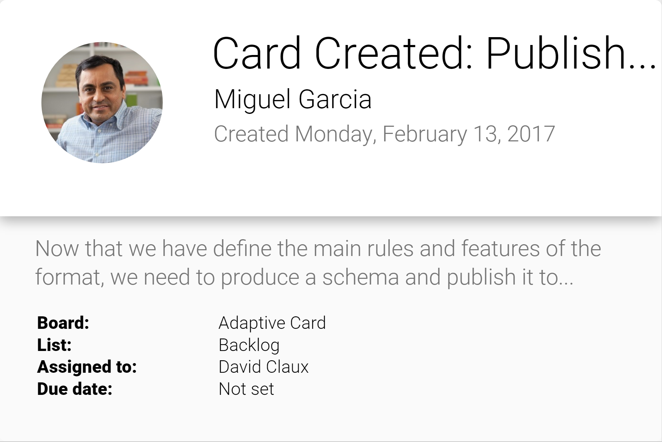
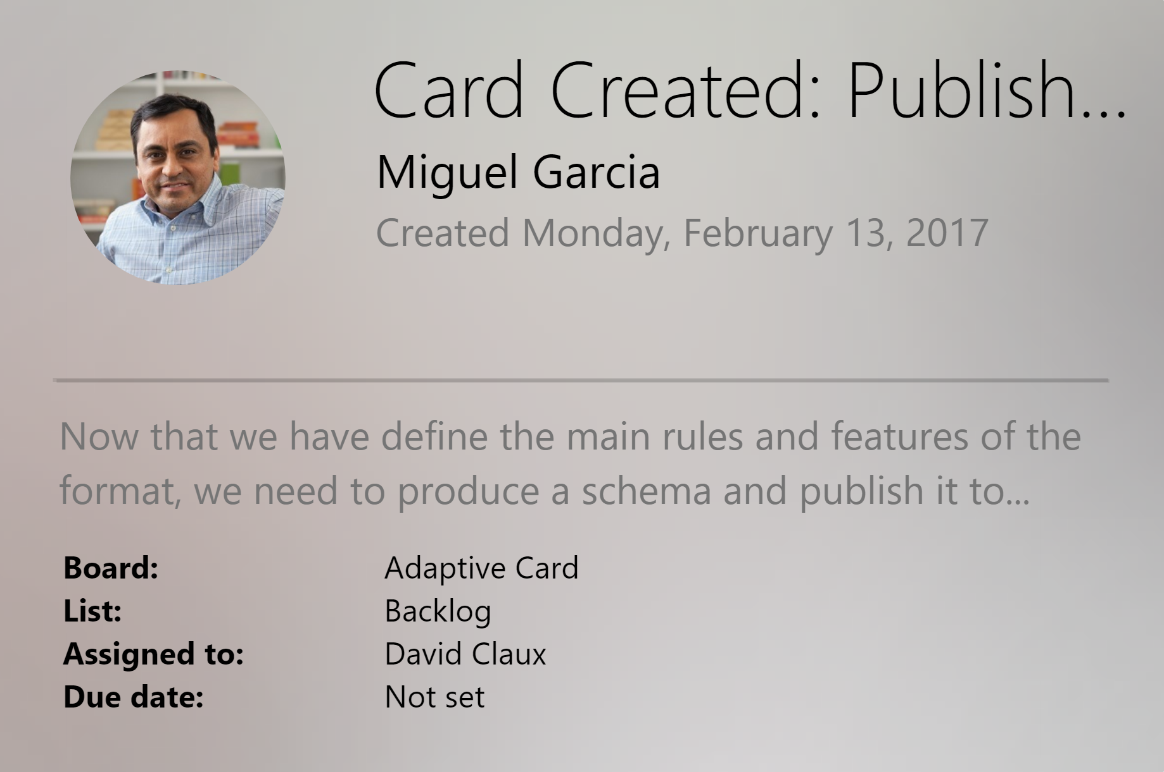
Adaptive cards
Open framework
Multiple canvases
Notification
Microsoft Teams
Skype
Android
iOS

Slide 17
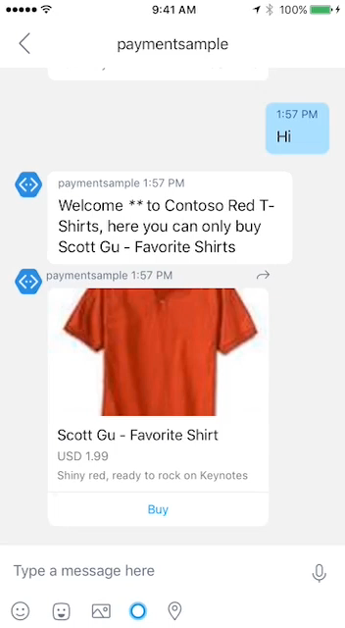
Payments
Stripe is currently supported
Visit Microsoft seller center
Obtain merchant ID
Start building
Works across most major platforms
Fast and simple payment experience
Bring commerce capabilities to your bot
Learn more on Microsoft Seller Center!
Read the integration guide for the bot framework

Slide 18
Speech
Deep Integration
Across the Bot Framework
SPEECH IN PROTOCOLS
SPEECH IN SDKS
SPEECH IN LUIS
DirectLine support
SSML
Modeled conversations
WebChat control
Speech friendly prompts
Common model (Cortana, Bing speech, custom speech recognition)
Cortana
Conversation management

Slide 19
LUIS
Language Understanding
Top requested features
More new features
Production staging and versioning
More languages (Dutch, Korean, dialects)
Increased intent and entity limits
25 customizable prebuilt domains
Lists
Improved recognizers(*)
Semantic dictionaries
Spell checking
(*) Recognizers are open-sourced

Slide 20
LUIS
Language Understanding
Pre-built domains
Examples of pre-built domains
Predefined packages
Bootstrap model creation
Customizable!
Sports
Weather
Stock
Contacts
Calendar
Restaurants
Entertainment
Fitness
Home automation
Music
Translation
Movie tickets

Slide 21
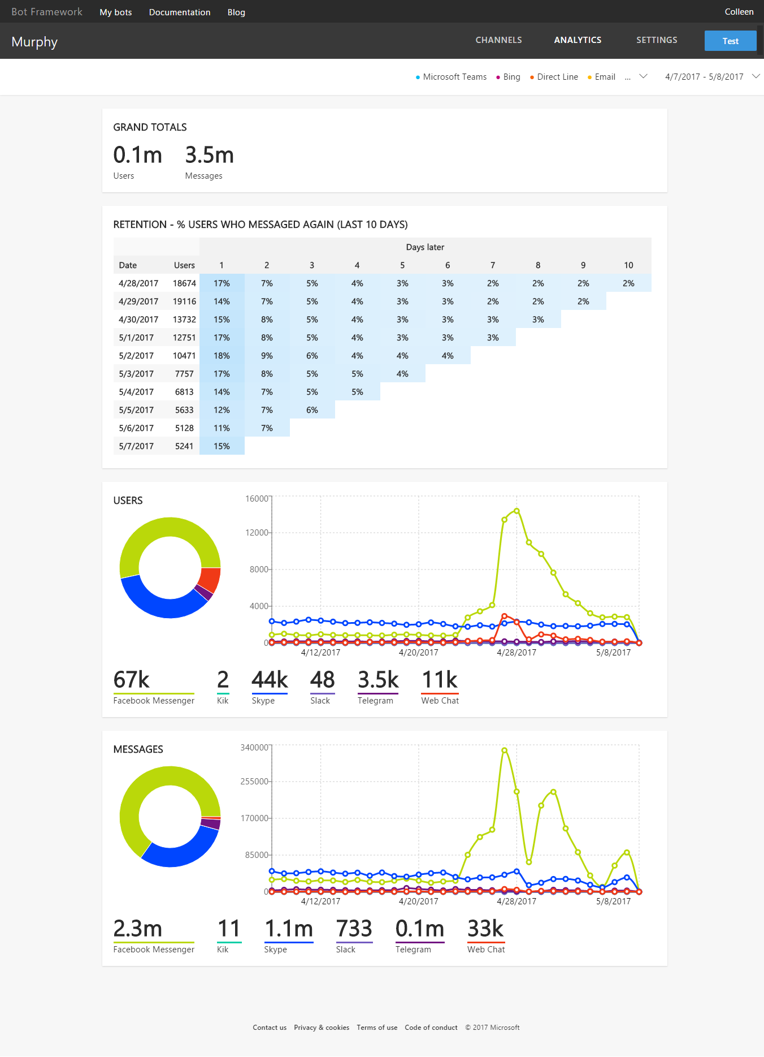
Bot analytics

Slide 22
Demo
LUIS lists and auto recommendations
Notes:
https://docs.microsoft.com/en-us/azure/cognitive-services/luis/add-features
5

Slide 23
Azure bot service v.Next
Sneak Peek
“One stop shop for building bots”
Highlights
Fully Azure integrated
Conversational vs. business logic
Richly tooled
Design; code; deploy; manage; analyze
Data stays in a user’s subscription
Improved perf via colocation
Bot + functions + LUIS runtime
SDK unification
Componentization and reuse

Slide 24
Demo
Azure Bot Service v.Next bot in action

Slide 25
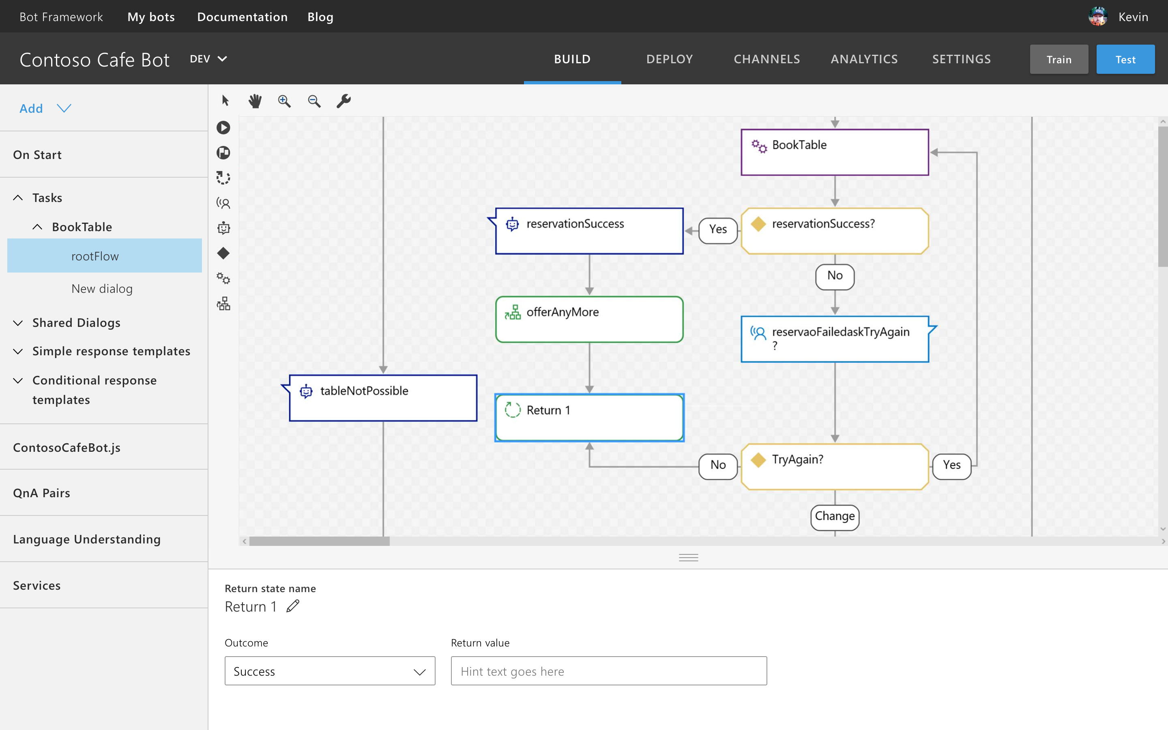
Azure bot service v.Next Conversation designer

Slide 26
Community engagement

Slide 27
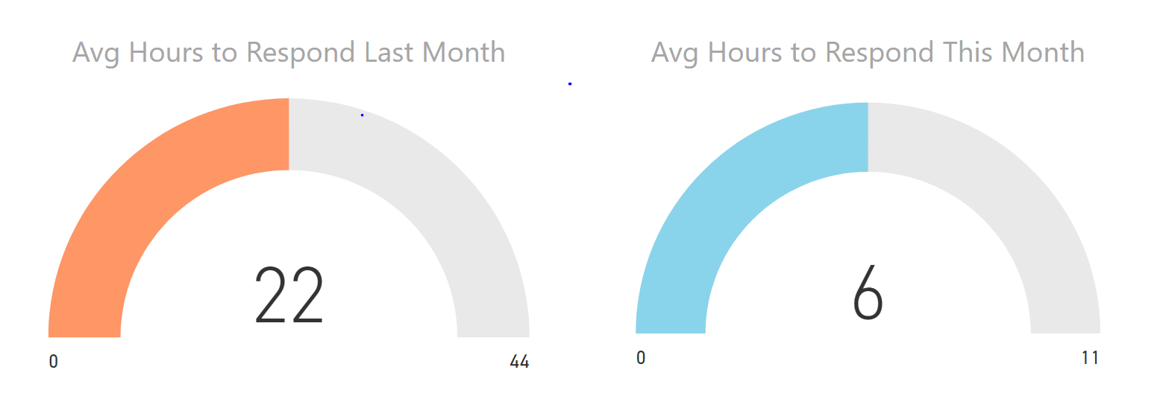
Support metrics, stack overflow
May
June

Slide 28
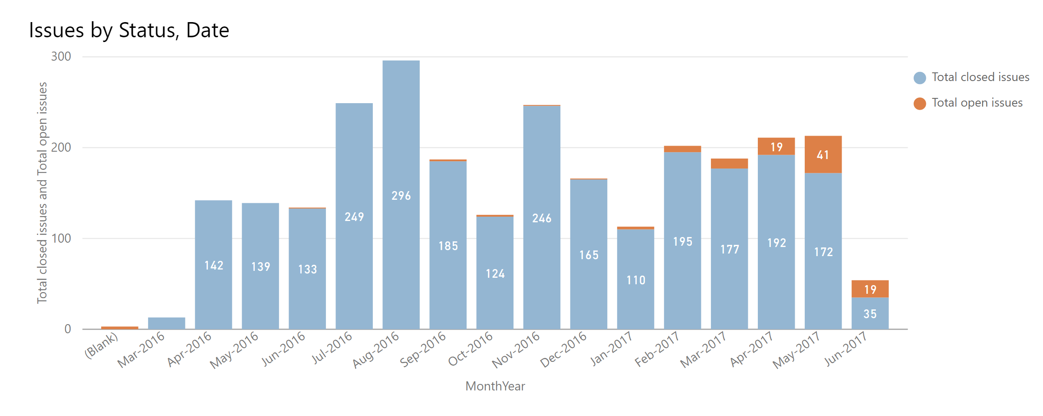
Support metrics, GitHub

Slide 29
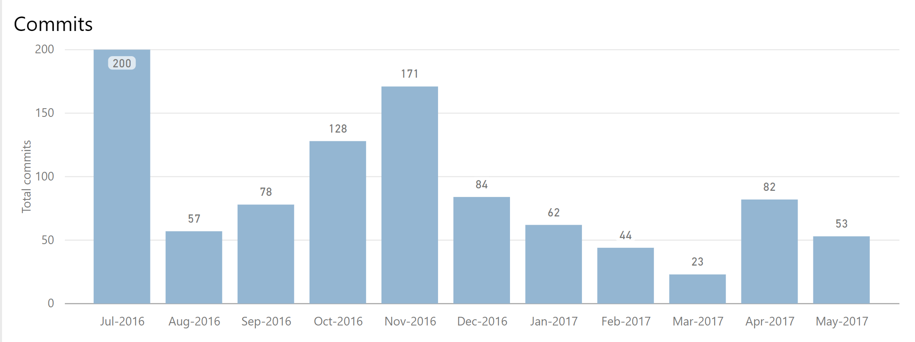
GitHub contributions
Vibrant community!

Slide 30
Call to action
Build bots—https://dev.botframework.com/
Docs—https://docs.microsoft.com/en-us/bot-framework/
GitHub—https://github.com/Microsoft/BotBuilder
Continue your education at Microsoft Virtual Academy online
#MSBuild

Slide 31
Bot framework roadmap 2017
Bot builder
Bot Controls++
Speech support
SDK V.Next
Ecosystem integrations
(Flow, PowerApps, ++)
Bot brain
GA
Localization
Protocols & services & channels
Analytics++
Adaptive cards
Bot federation
Compliance
GA
Regions++, Channels++
May
Aug
Nov
Bot INTELLIGENCE
Regions++, Languages++, Domains++
ML dialogs
Prebuilt domains
Multi-developer
Faster training
Speech services++
Pattern support
GA
Azure bot service v2
Sneak peak
Preview

Slide 32
Questions?
Contact

Slide 33


What is the bot framework?
Build and connect intelligent bots
The bot framework provides tools and resources for designing, building, deploying, and managing bots
Network of Microsoft customers
Bots connect to Microsoft properties, such as Cortana, LinkedIn, Skype, and Office 365

Slide 34
Bot example Azure Services integration via SMSG
Task completion and general knowledge are fundamental to every Bot we deliver
Language understanding, translation, spellcheck, and sentiment cognitive services are key
Dynamics 365 Knowledgebase provides a comprehensive and agile way to provide general knowledge to the Bot and tooling to the customer to manage knowledge and feedback and to manage support cases
Application insights provides highly impactful insight into technical and end user value

Slide 35
Bot framework surface area
Bot builder
Tools for conversational modeling, bot memory, and integration of business logic
Core platform Provide developer broad access to Microsoft customers via Microsoft properties
AI and resources Democratization of AI resources such as language understanding, QnA Maker, and other cognitive services

Slide 36
Payment card schema
Combination of bot framework and W3C Payment Request standard
Familiar to bot devs, familiar to commerce devs
{
"type": "message",
"from": { "id": "12345" },
"conversation": { "id": "67890" },
"attachments": [{
"contentType": "application/vnd.microsoft.card.payment",
"content": {
"merchantId": “23812529525",
"paymentMethodData": {
"supportedMethods": ["visa", "bitcoin"],
},
"paymentDetails": {
"total": {
"label": "Lawn Dart -- this is definitely not a dangerous toy",
"amount": { "currency": "USD", "value": "88.51" }
},
"shippingOptions": [{
"id": 'STANDARD',
"label": "Standard Shipping",
"amount": { "currency": "USD", "value": "12.52" },
"selected": "true"
}, {
"id": "EXPEDITED",
"label": "Two-Day Shipping",
"amount": { "currency": "USD", "value": "32.99" },
}]
},
"paymentOptions": {
"requestPayerEmail": "true",
"requestShipping": "true"
},
"paymentEventUrl": "https://happyfuntoys.azurewebsites.net/api/payments",
"paymentEventState": { "data": "ABC1234" }
}
}]
}
Bot Framework protocol
W3C Schema

Slide 37
Worldwide footprint
Service
LUIS(*)
DirectLine
Locations
North America (x2)
SE Asia
West Europe
North America (x3)
SE Asia
West Europe
China (Coming Soon)
(*) LUIS goes “On-Box” with the Azure Bot Service v2. Details later in this deck.

